Slide 1



Mind Reading By Computer
By: Mrunali Bhujbal
Karuna Liman

Slide 2

Introduction
How does it Work
Process
Techniques
Web search
Application
Advantages & Disadvantages
Conclusion

Slide 3

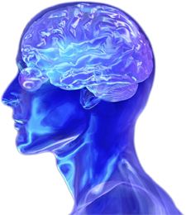
People express their mental states
This is true even when they are interacting with machines.
Our mental states shape the decisions that we make, govern how we communicate with others, and affect our performance.
Theory of mind or mind-reading.

Slide 4

Functional near-infrared spectroscopy (fNIRS).
The user wears a sort of futuristic headband.
The results are often compared to an MRI.
It can be gathered with lightweight, non-invasive equipment.

Slide 5

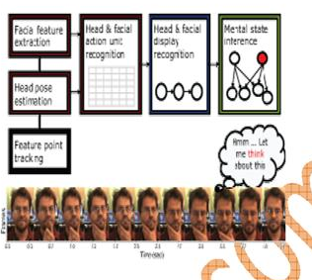

Slide 6

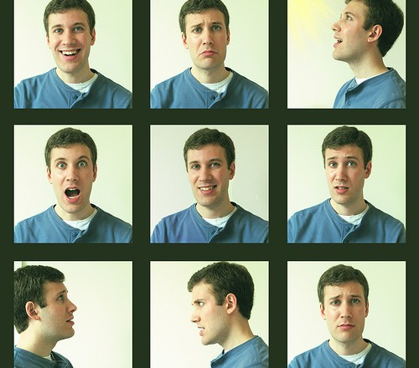
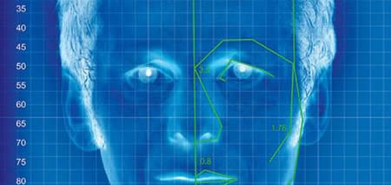
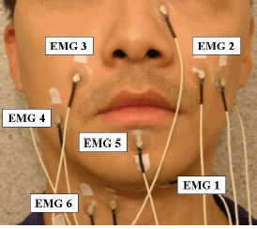

Facial Affect Detection
Emotional Classification
Facial Electromyography
Blood Volume Pulse

Slide 7


Six words - including "go", "left" and "right" - and 10 numbers.
The software correctly picked up the signals 92 per cent of the time.
Put the letters of the alphabet into a matrix with each column and row labeled with a single-digit number.

Slide 8

Facial recognition.
Help Paralytic Patients.
Marketing.
Knows what the Eye can see.
Converts Thoughts into Speech.
Can be used for Sting Operations.

Slide 9

Can read minds.
Help paralytic patients.
Help Handicapped people.
Help Comma patients.
Can be used for military purposes & sting operations.
Help people who can’t speak.

Slide 10

Breach in privacy.
Can’t make good lies.
Risk of being used in wrong way.
Expensive.

Slide 11

How mind reading is done using some techniques.
Different working areas of mind reading computer.

Slide 12


